Slide 1

Management – Colombia

Slide 2
Management Score Colombia (Industry Edit 2018) vs. USA (Annual Survey of Manufactories 2010 and 2015)
Statistic (mean) | Colombia | USA
Management(1-16) | 0.37 | 0.61
No Incentives (1-8) | 0.55 | 0.64
Incentives (9-16) | 0.22 | 0.58
Size (Firm Employment) | 125.5 | 177
Source: Iacovone / Fernández (2020) and Bloom (2019)

Slide 3
Employment and Management Colombia
Source: Iacovone / Fernández (2020) and Bloom (2019)

Slide 4
Performance and Management
Performance measured by the average of:
Labor productivity
Exports,
Operating Profit
IP registers,
Wage per Employee,
Investment on Research, Development and Innovation.
Source: Iacovone / Fernández (2020)

Slide 5
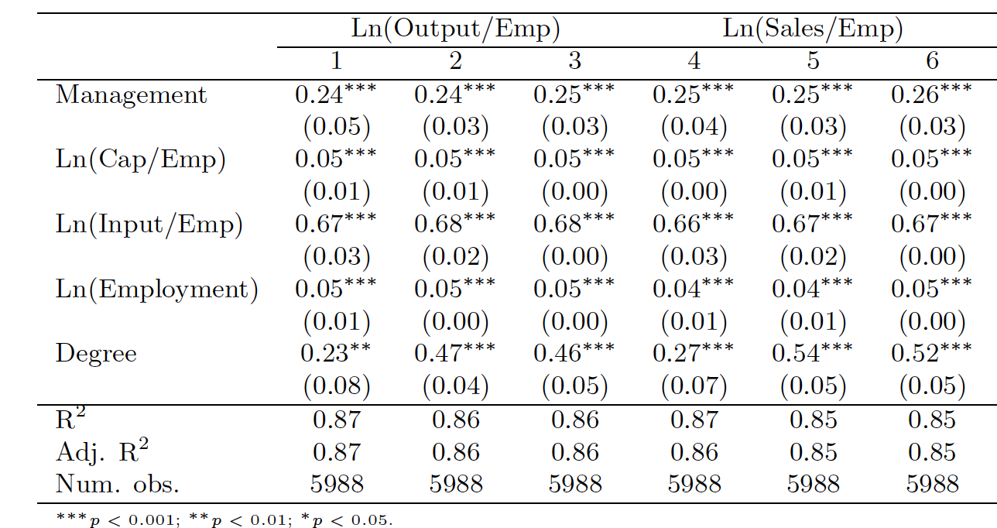
Firm Management Score and Performance (1)
Equation
Source: Iacovone / Fernández (2020)

Slide 6
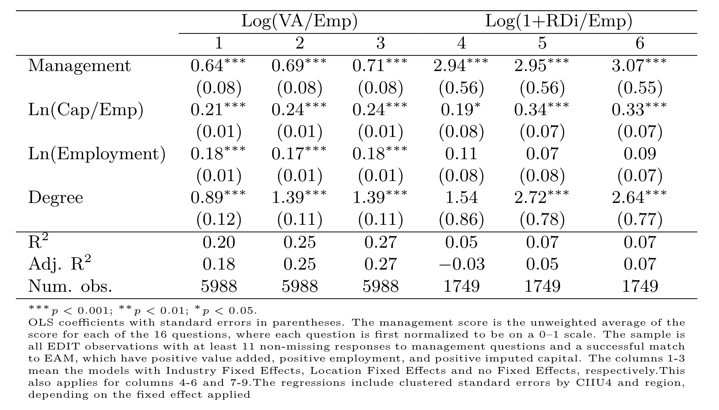
Firm Management Score and Performance (2)
Log - Level
Source: Iacovone / Fernández (2020)

Slide 7
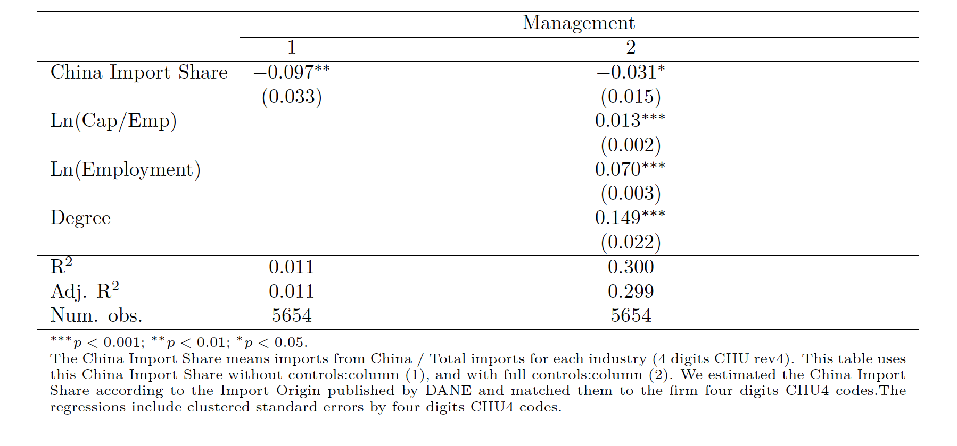
China Import Share and Management
Level – Level
Negative sign
Source: Iacovone / Fernández (2020)

Slide 8
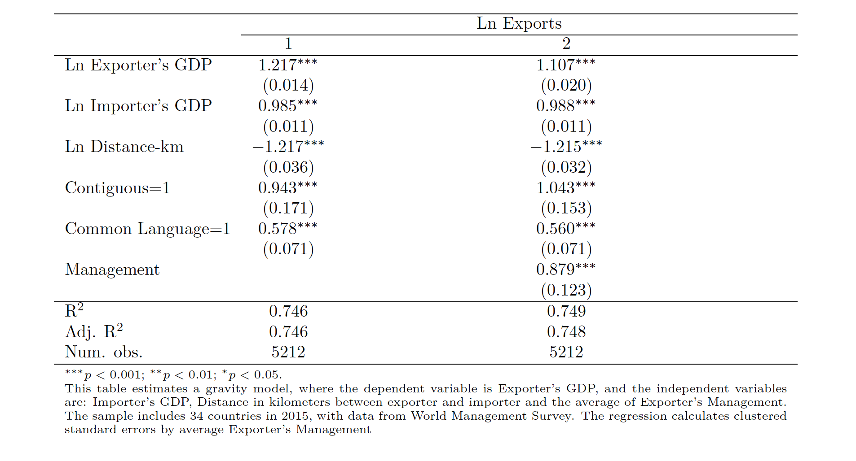
Gravity Equation and Management
Equation
Positive Sign
Log - level
Source: Iacovone / Fernández (2020)

Slide 9
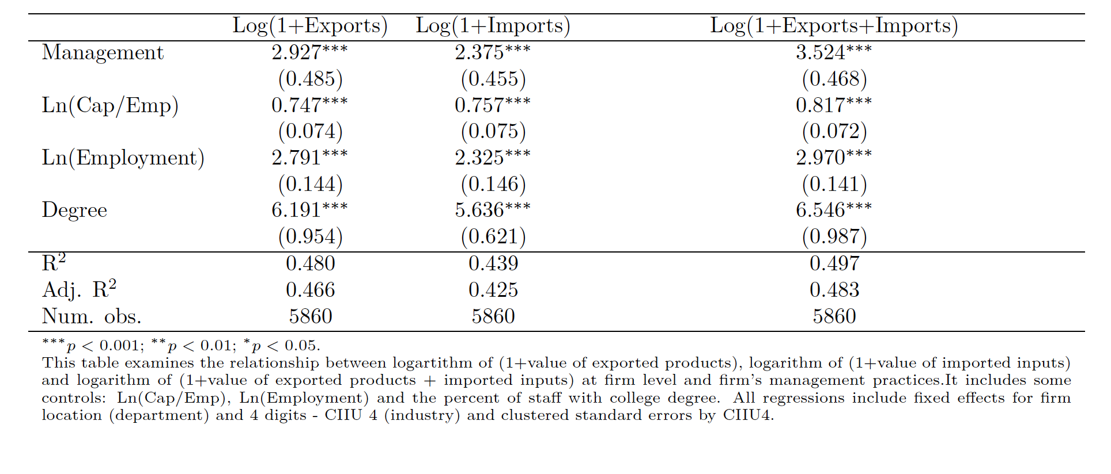
Trade Outcomes and Management
Log – Level
Negative sign
Source: Iacovone / Fernández (2020)

